Slide 1


International Institute Of Professional Studies Devi Ahilya Vishwavidyalaya , Indore
Project Proposed :- Employee loan Management
Guided By :- Prepared By :-
Dr. Nitin Nagar Yashika Sharma Mahima Yogi Anubhav Singh

Slide 2
Points to be covered :-
Introduction
Current system
Advantages over existing system
Modules in brief
SDLC
ER Model

Slide 3
Introduction
In finance, a loan is the lending of money from one individual, organization or entity to another , organization or entity.
TYPES OF LOANS
Student loan
Auto loan
Home loan
Small business loan
Personal loan
Gold loan

Slide 4
Current System
The need for loans is increasing day by day. the major portion of population applying for loan belongs to the middle class families. There are a lot of difficulties and hardships faced by people. These include:
PAPER WORK AND LONG PROCEDURES
BANK FRAUD
RECORDS MANUPULATION
HIGH RATE OF INTEREST

Slide 5
Advantages over existing system
The major objectives of the proposed system which makes it a better choice are:
Reduced Risk
Optimized Processing Time
Mobility of Users
Reduced Lending Cost
Management Control
Customer Satisfaction

Slide 6
Modules in Brief
Agreement Management
Application Form For Loans
Risk Assessment
Loan Pricing
Work Flow
Document Archiving/Management
Loan Committee
Monitoring
Reports

Slide 7
Sequential Life Cycle Model (SDLC) Waterfall Model
An SDLC Waterfall model includes different phases which are as follows :-
Requirement gathering and analysis.
System design.
Implementation.
Integration and Testing.
Deployment.
Maintenance.

Slide 8
Waterfall Model
Requirement analysis
System design
Implementation
Testing
Deployment
Maintenance

Slide 9
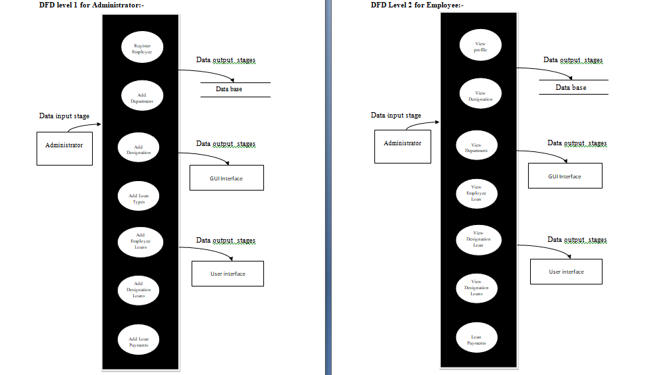
DATA FLOW DIAGRAM (DFD)
LEVEL 1 LEVEL 2

Slide 10
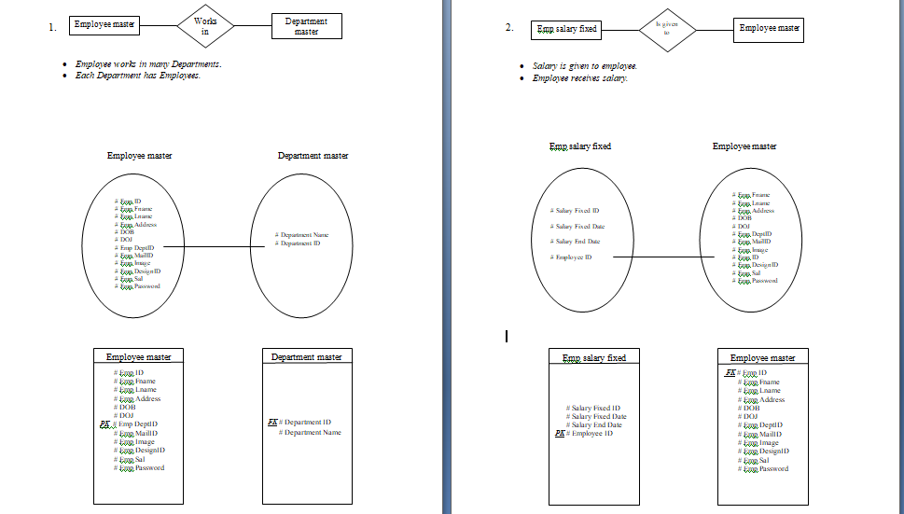
ER MODEL
1.Relationship between Employee and Department. 2. Relationship between Employee and its Salary

Slide 11
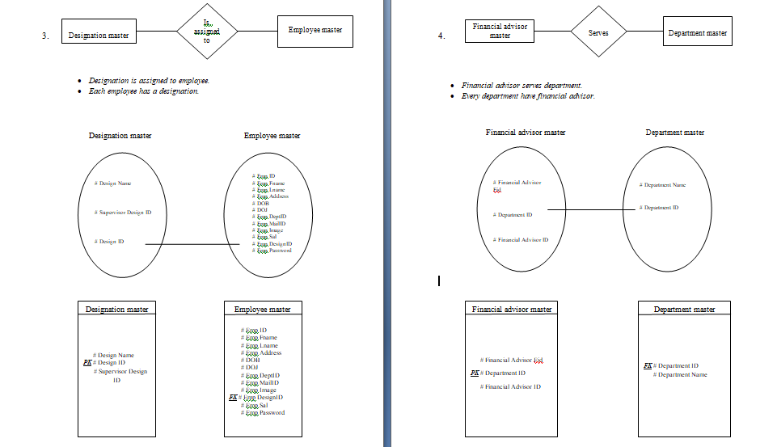
ER MODEL
3. Relationship between Employee and 4. Relationship between Financial adviser
its Designation and Department

Slide 12
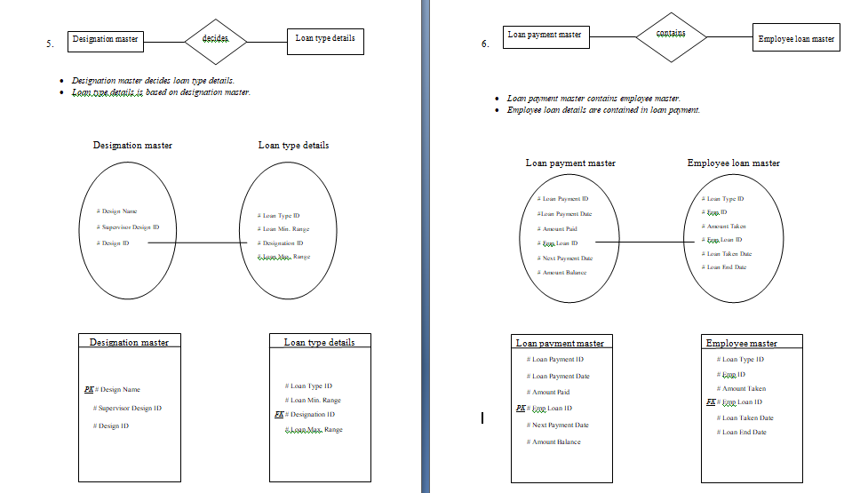
ER MODEL
5.Relationship between Employee designation 6. Relationship between Loan payment and Loan type and Employee loan

Slide 13
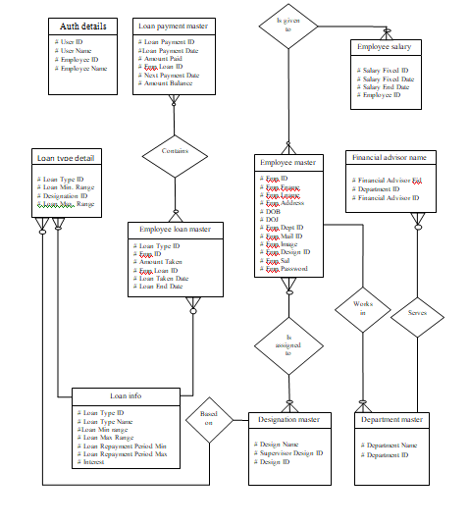
ER Diagram

Slide 14
THANK YOU

